Slide 1
Stochastic Analysis of Real and virtual storage in the smart grid
Jean-Yves Le Boudec,
joint work with Nicolas Gast
Dan-Cristian Tomozei
I&C
EPFL
IEEE-Greencom keynote, Cyberspace, September 2012

Slide 2
INTroduction
1.

Slide 3
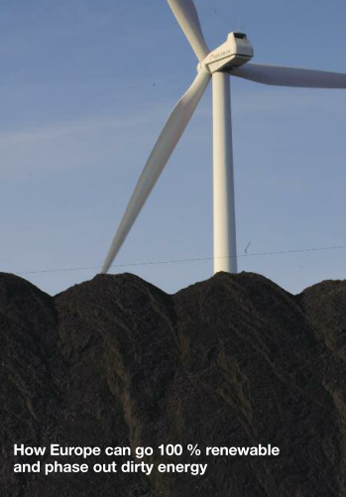
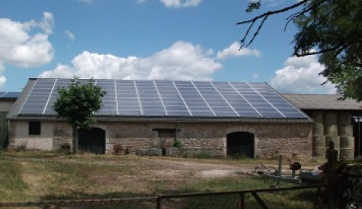
Renewable but non dispatchable
Wind and PV require some mechanisms to compensate non dispatchability
Source: «Battle of the grids», Greenpeace, Report 2011.
Notes:
« I am 100% autonomous with my PV roof»

Slide 4

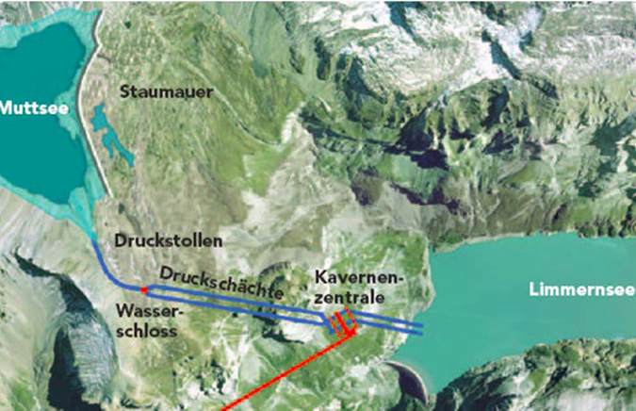
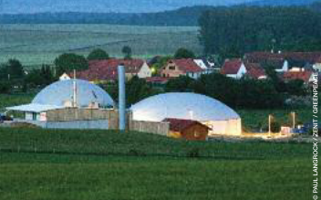
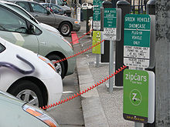
Renewable Methods to Compensate for Fluctuations of PV and Wind
Dispatchable renewables
Storage
Demand Response
Notes:
Nant de Dranse (VS) source: CREM

Slide 5
A MODEL OF DEMAND RESPONSE
2.
Le Boudec, Tomozei, Satisfiability of Elastic Demand in the Smart Grid, Energy 2011 and ArXiv.1011.5606

Slide 6
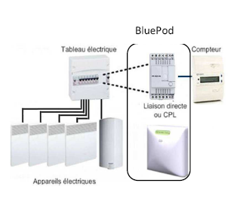
Demand Response
= distribution network operator may interrupt / modulate power
elastic loads support graceful degradation
Thermal load (Voltalis), washing machines (Romande Energie«commande centralisée») e-cars
Voltalis Bluepod switches off thermal load for 60 mn

Slide 7
Issue with Demand Response: Grid Changes Load
Widespread demand response may make load hard to predict
load with demand response
«natural» load
renewables

Slide 8
Our Problem Statement
Does demand response work ?
Delays
Returning load
Problem Statement Is there a control mechanism that can stabilize demand ?
We make a macroscopic model of a transmission grid with large penetration of
Demand response
Non dispatchable renewables
We leave out for now the details of signals and algorithms

Slide 9
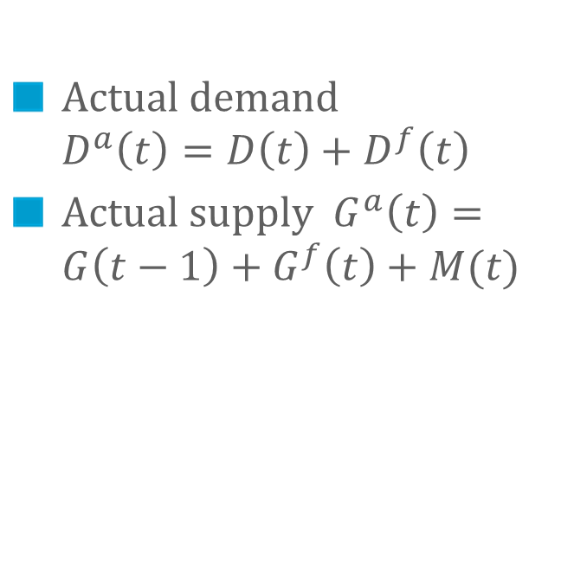
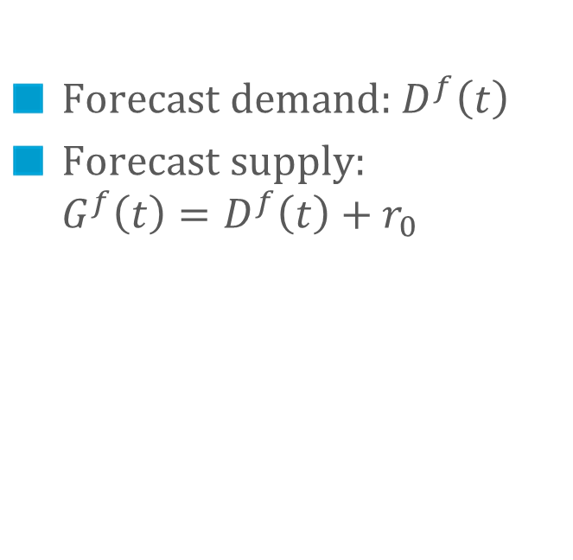
Starting Point: Macroscopic Model of Cho and Meyn [1], without Demand Response
Step 1: Day-ahead market
Step 2: Real-time market
Forecast demand: $D^{f}\left(t\right)$
Forecast supply: $G^{f}\left(t\right)=D^{f}\left(t\right)+r_{0}$
Actual demand $D^{a}\left(t\right)=D\left(t\right)+D^{f}\left(t\right)$
Actual supply$G^{a}\left(t\right)=G\left(t−1\right)+G^{f}\left(t\right)+M(t)$
deterministic
nominal reserve
random (deviation from forecast)
control (real time adjustement of
Generation)

Slide 10
We add demand response to the model
We capture two effects of Demand Response
Some load is delayed
Returning load is modified
We do not model the IT aspects
Operation of Demand response is instantaneous (but has delayed impact)
Notes:
Different temperature conditions (inside, outside) when load returns
Different charging rate (resistive losses)

Slide 11
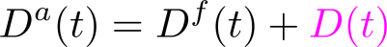
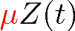
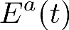

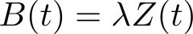
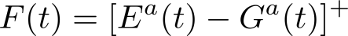
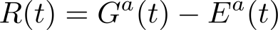
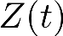
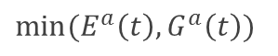
Our Macroscopic Model with Demand Response
Control
Ramping Constraint
Randomness
Supply
Natural Demand
Evaporation
Expressed
Demand
$$min⁡(E^{a}\left(t\right), G^{a}\left(t\right))$$
Satisfied
Demand
Returning Demand
Frustrated
Demand
Reserve
(Excess supply)
Backlogged Demand

Slide 12
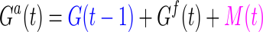
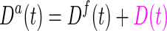
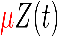
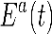
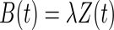
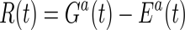
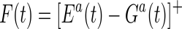
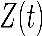
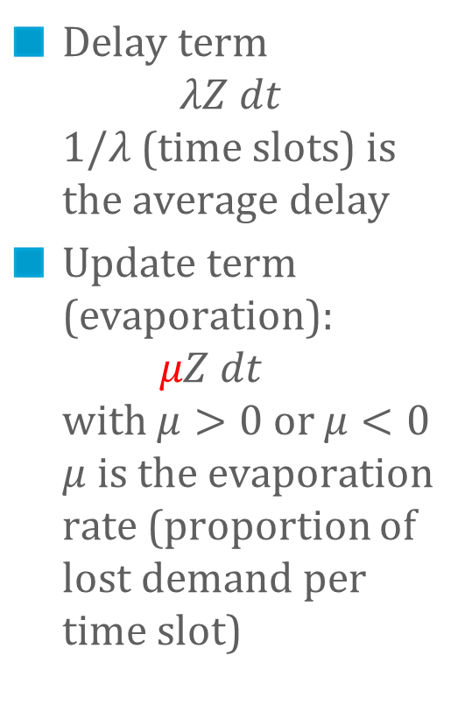
Demand that was subject to demand response is later re-submitted
Control
Delay term $λZ dt$ $1/λ$ (time slots) is the average delay
Update term (evaporation): $μZ dt$ with $μ>0$ or $μ<0$ $μ$ is the evaporation rate (proportion of lost demand per time slot)
Randomness
Supply
Natural Demand
Evaporation
Expressed
Demand
Satisfied
Demand
Returning
Demand
Frustrated
Demand
Reserve
(Excess supply)
Backlogged Demand

Slide 13
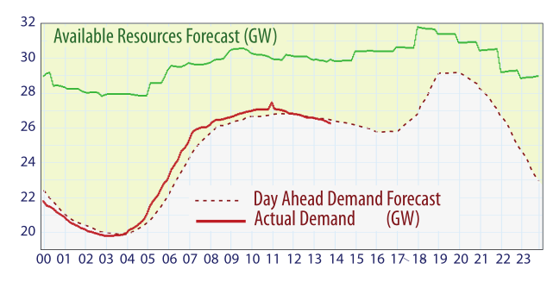
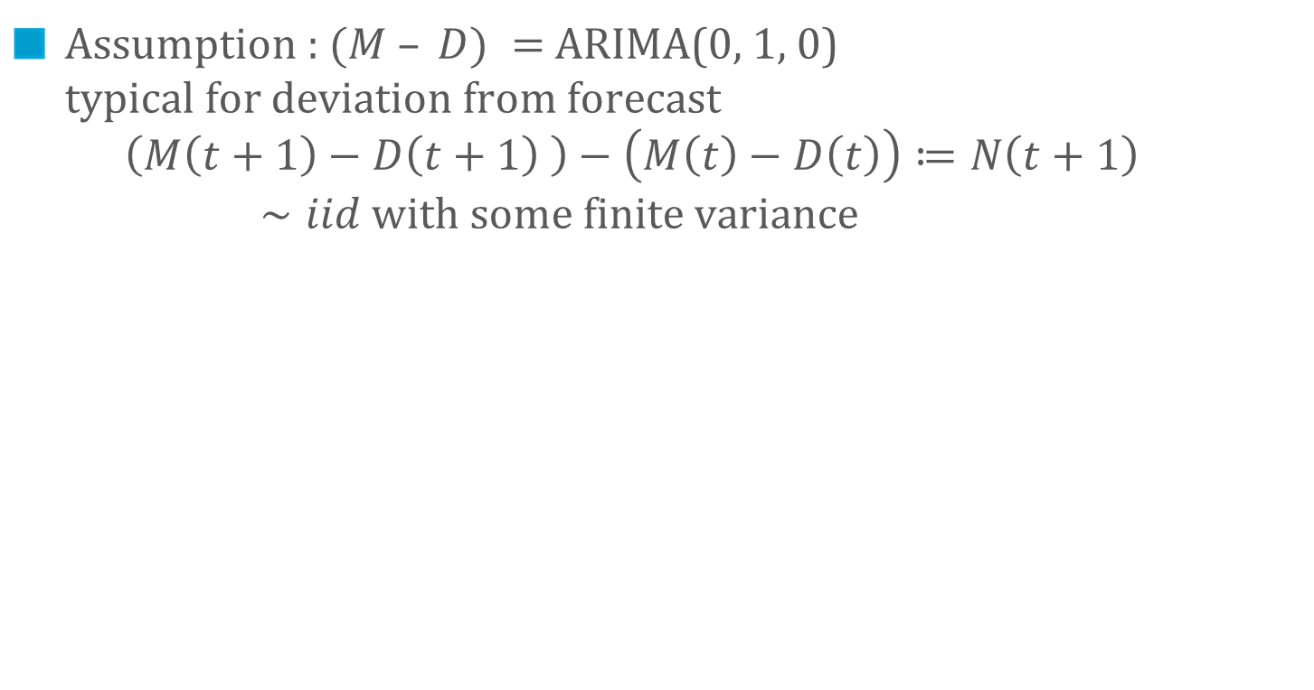
Deviations from Forecasts
Assumption : $(M – D) =$ ARIMA(0, 1, 0) typical for deviation from forecast $\left(M\left(t+1\right)−D\left(t+1\right) \right)−\left(M\left(t\right)−D\left(t\right)\right)≔N\left(t+1\right)∼iid with some finite variance$
S. Meyn
“Dynamic Models and Dynamic Markets
for Electric Power Markets”

Slide 14
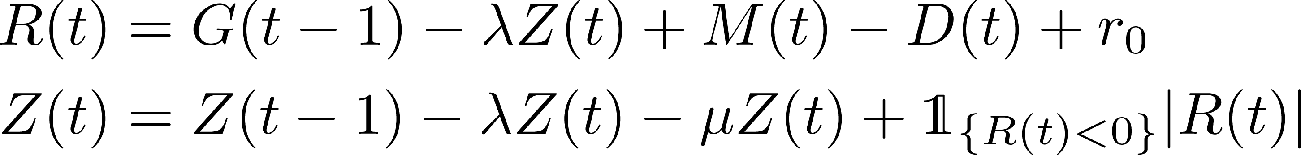
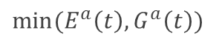
We obtain a 2-d Markov chain on continuous state space
Control
Ramping Constraint
Randomness
Supply
Natural Demand
Evaporation
Expressed
Demand
$$min⁡(E^{a}\left(t\right), G^{a}\left(t\right))$$
Satisfied
Demand
Returning Demand
Frustrated
Demand
Reserve
(Excess supply)
Backlogged Demand

Slide 15
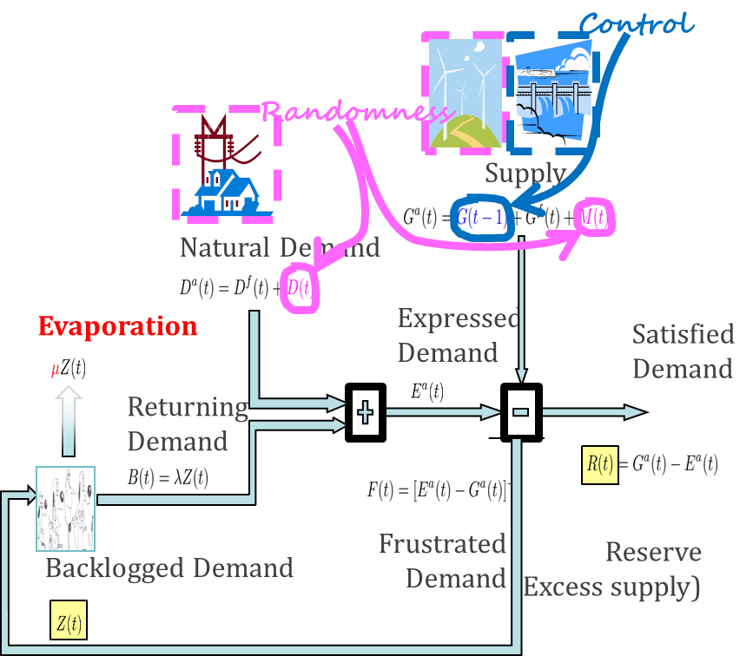
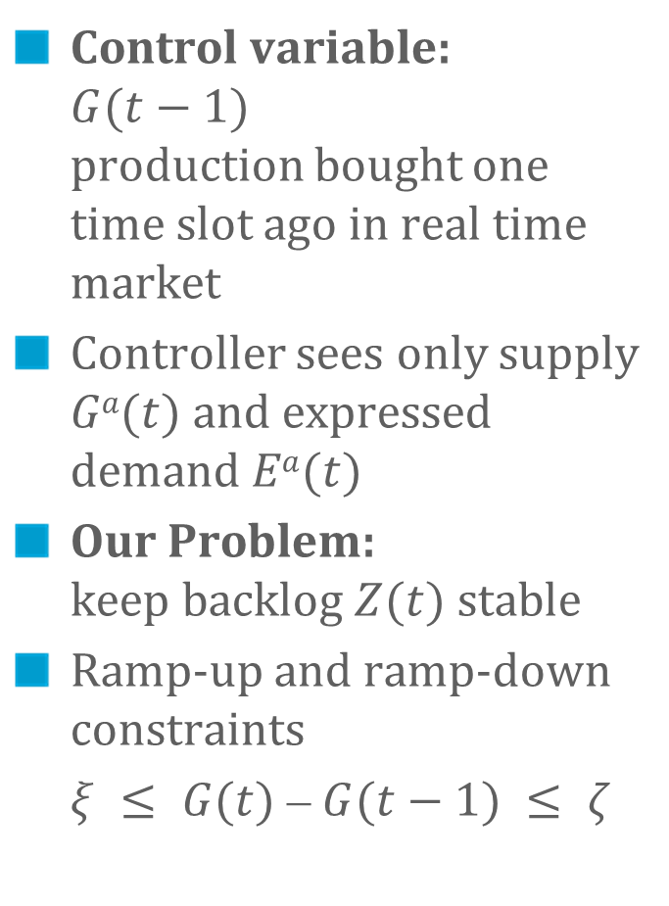
The Control Problem
Control variable: $G(t−1)$ production bought one time slot ago in real time market
Controller sees only supply $Ga(t)$and expressed demand $Ea(t)$
Our Problem: keep backlog $Z(t)$ stable
Ramp-up and ramp-down constraints
$ξ ≤ G(t) ⎼ G(t−1) ≤ ζ$

Slide 16
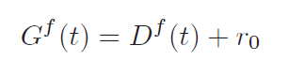
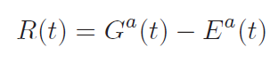
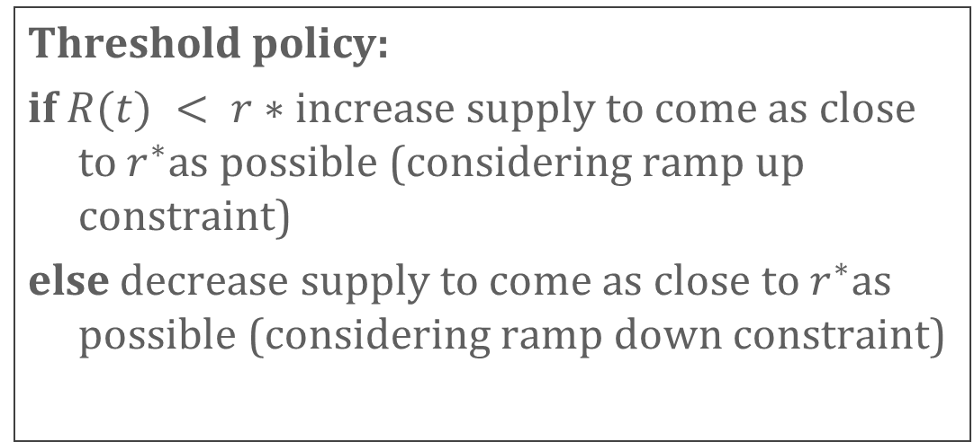
Threshold Based Policies
Forecast supply is adjusted to forecast demand
R(t) := reserve = excess of demand over supply
Threshold policy:
if $R(t) < r∗$increase supply to come as close to $r^{∗}$as possible (considering ramp up constraint)
else decrease supply to come as close to $r^{∗}$as possible (considering ramp down constraint)

Slide 17
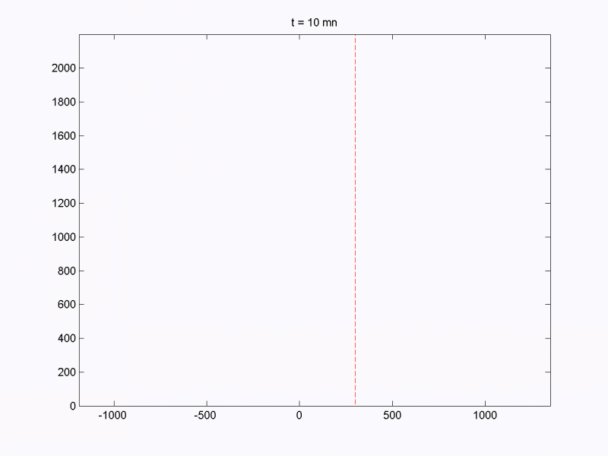
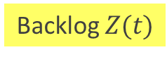
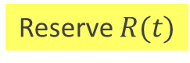

Simulations (evaporation $μ>0$)
Backlog $Z(t)$
Reserve $R(t)$

Slide 18
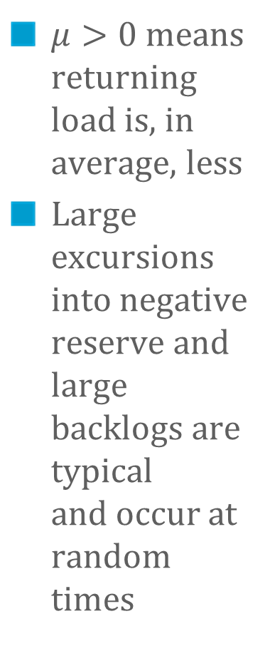
Simulations (evaporation $μ>0$)
r*
$μ>0$ means returning load is, in average, less
Large excursions into negative reserve and large backlogs are typical and occur at random times
1 time step = 10mn

Slide 19
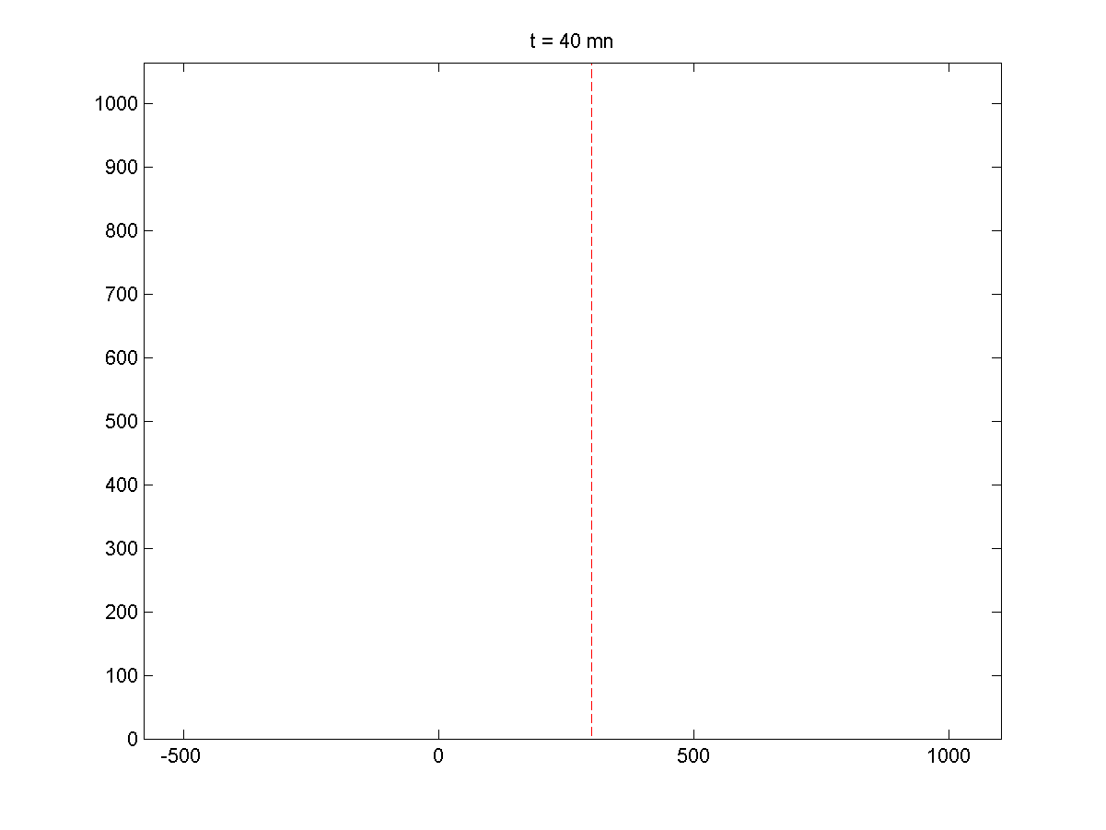
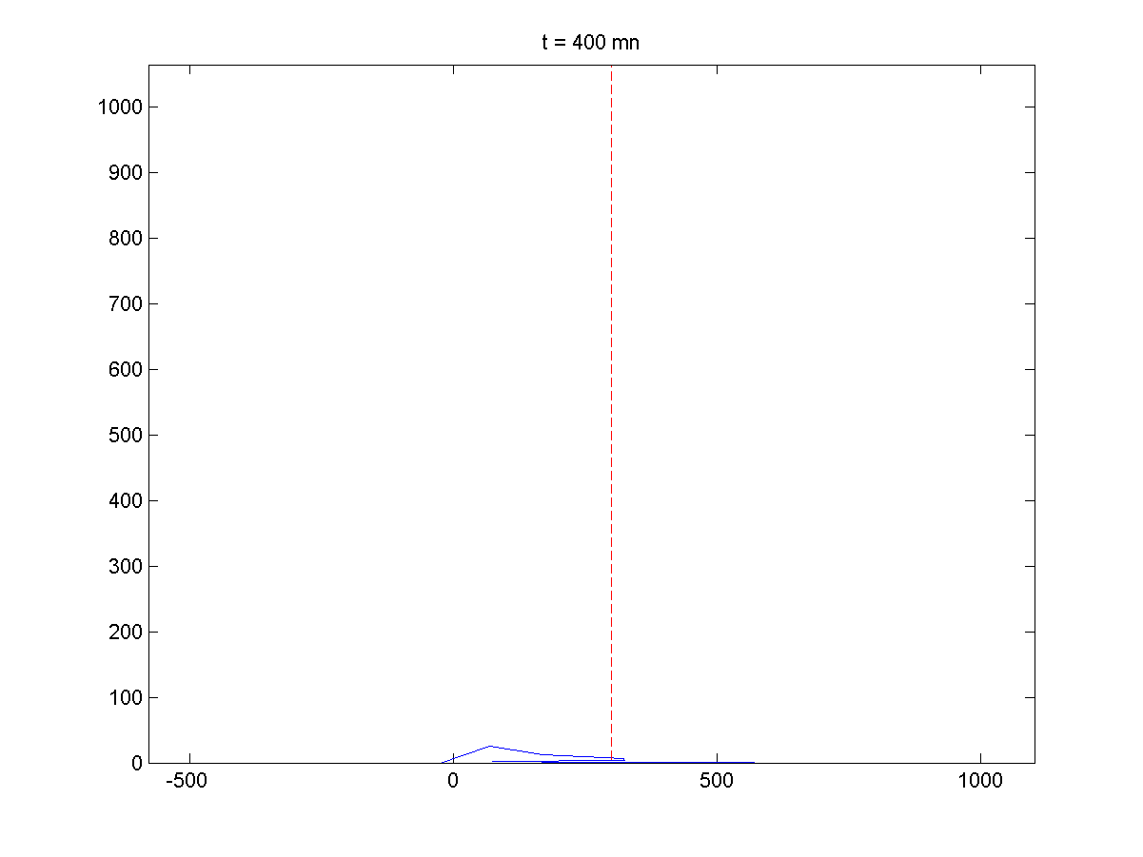
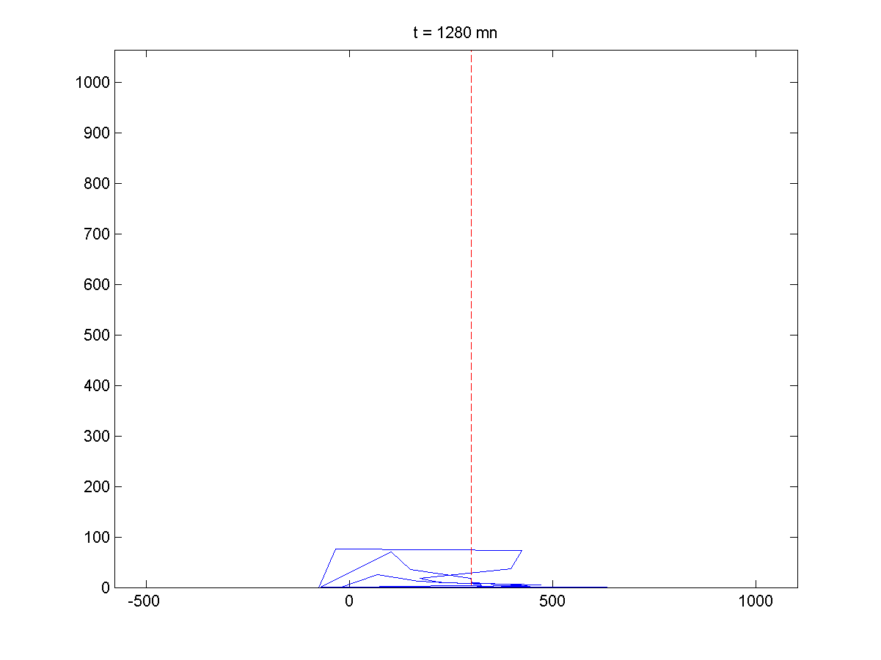
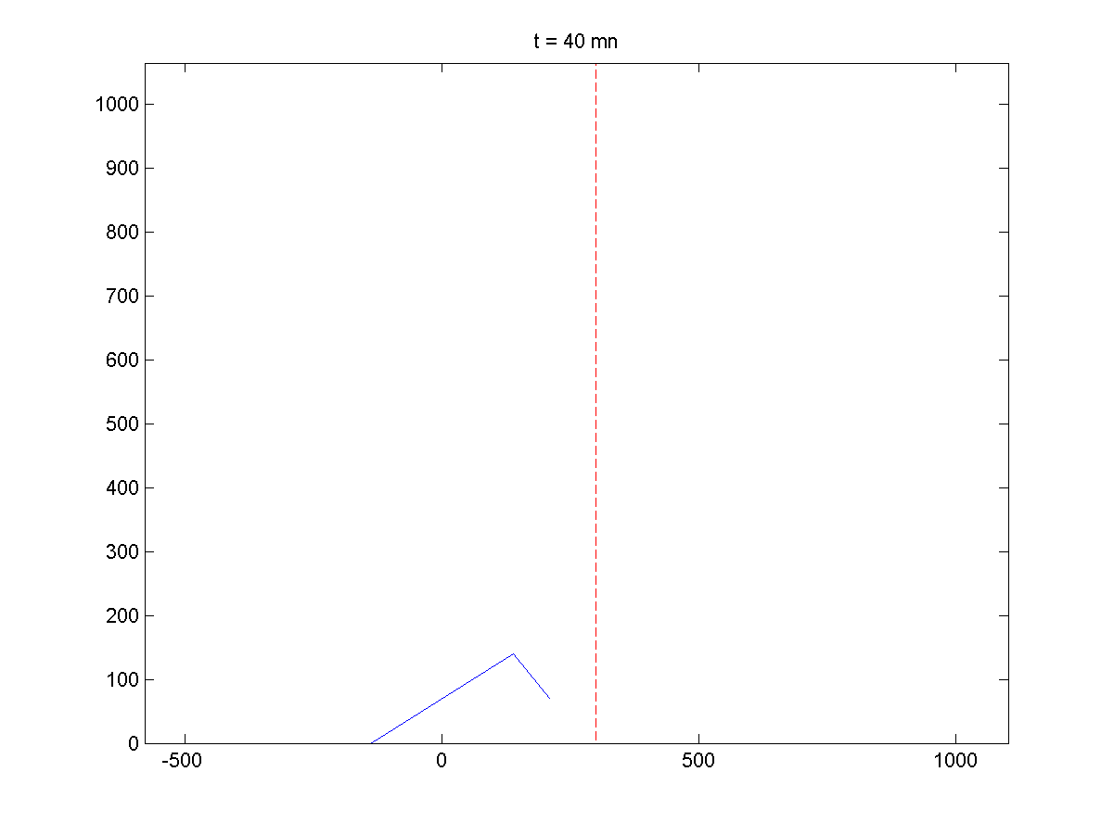
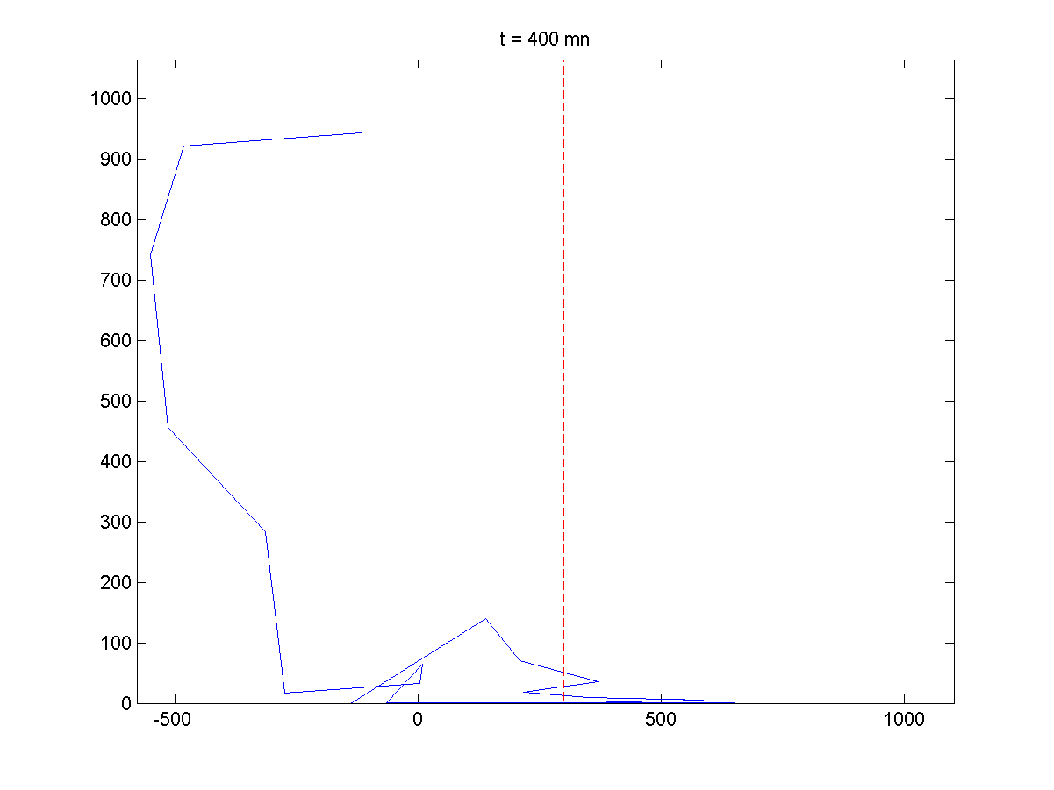
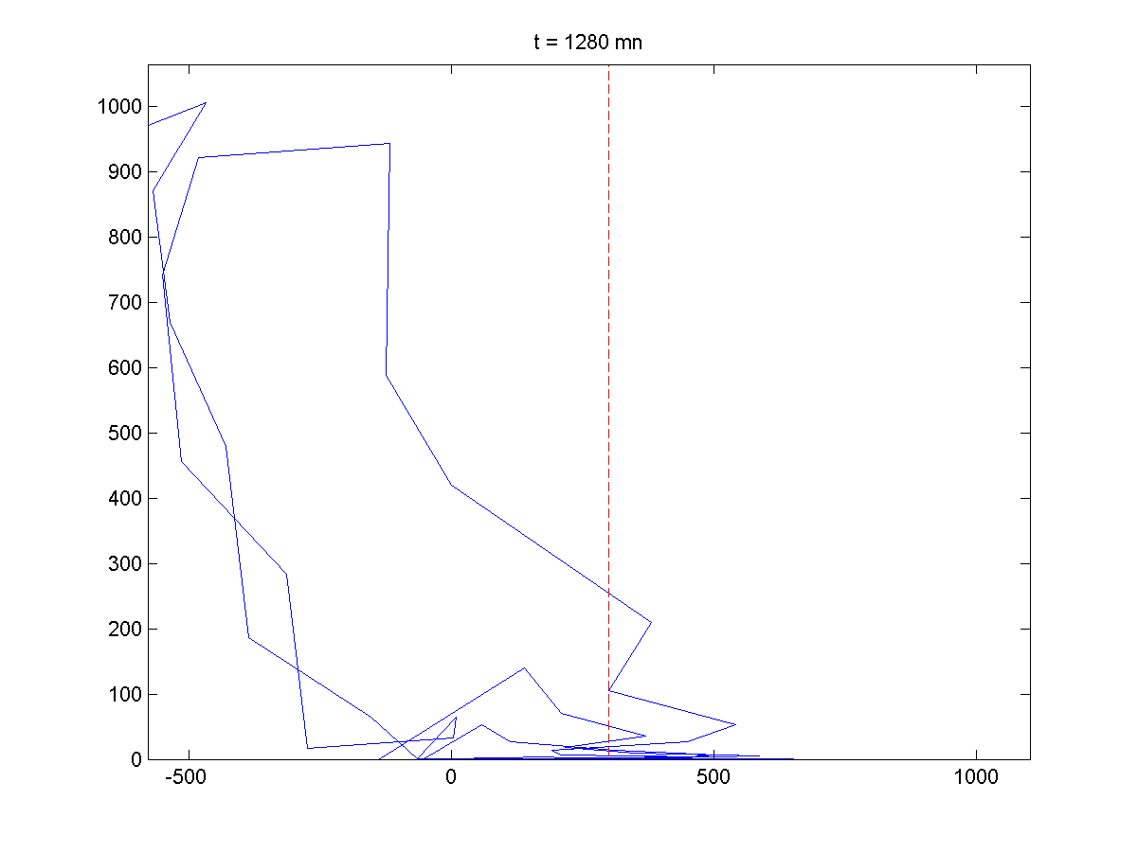

Large backlogs may occur within a day, at any time (when evaporation $μ>0$)
t = 40 mn
t = 400 mn
t = 1280 mn
Day 1
t = 40 mn
t = 400 mn
t = 1280 mn
Day 2
Typical delay $\frac{1}{λ}=$30 mn, all simulations with same parameters as previous slide, $σ=160$

Slide 20

ODE Approximation ($μ>0$) explain large excursions into positive backlogs
r*

Slide 21
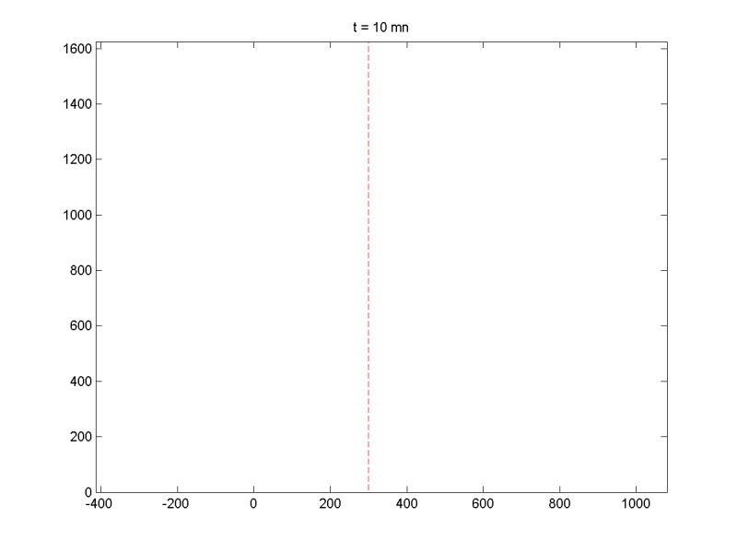

Simulations (evaporation $μ<0$)
Backlog $Z(t)$
Reserve $R(t)$

Slide 22
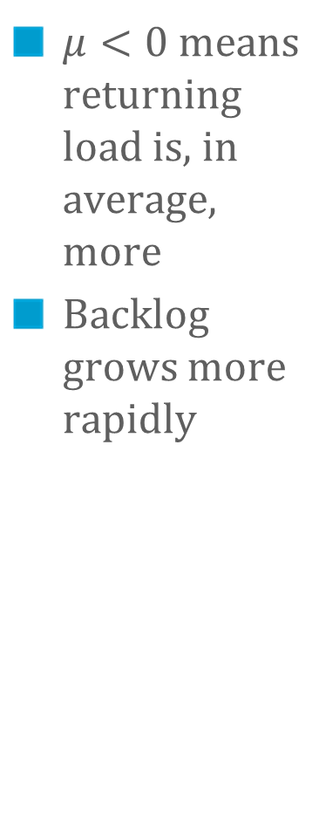

Simulations (evaporation $μ<0$)
$μ<0$ means returning load is, in average, more
Backlog grows more rapidly
$ξ=ζ=100, μ=−{0.15}^{,}r^{∗}=300$ 1 time step = 10mn

Slide 23

ODE Approximation ($μ<0$) shows backlog is unstable

Slide 24
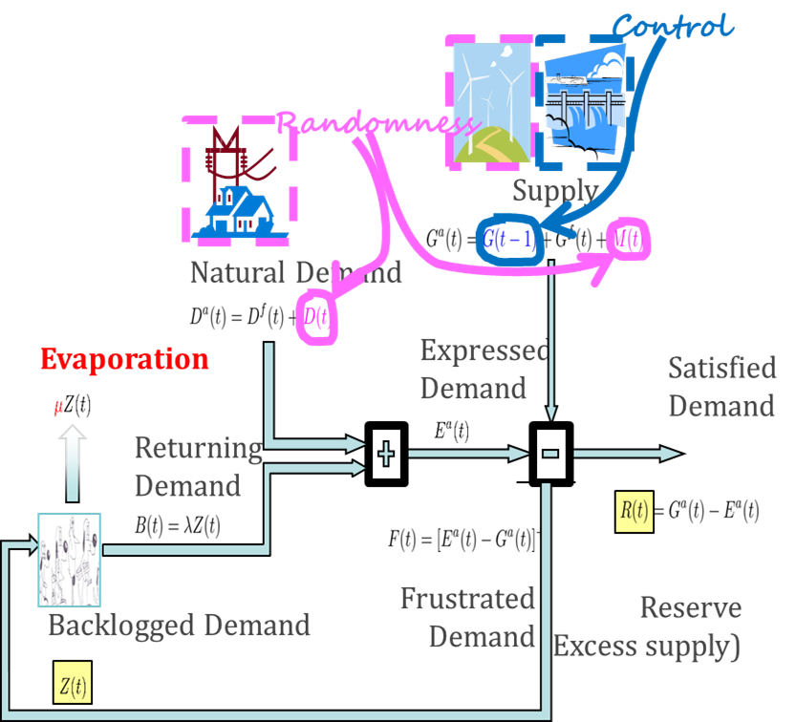
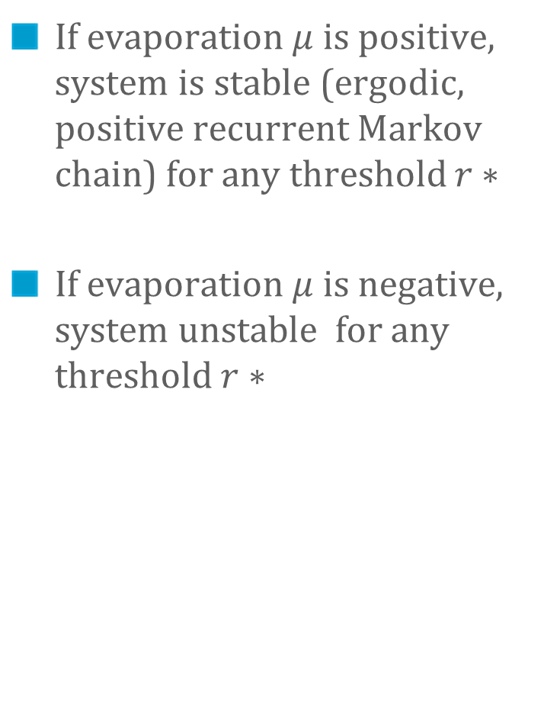
Findings : Stability Results
If evaporation $μ$ is positive, system is stable (ergodic, positive recurrent Markov chain) for any threshold $r∗$
If evaporation $μ$ is negative, system unstable for any threshold $r∗$
Delay does not play a role in stability
Nor do ramp-up / ramp down constraints or size of reserve

Slide 25
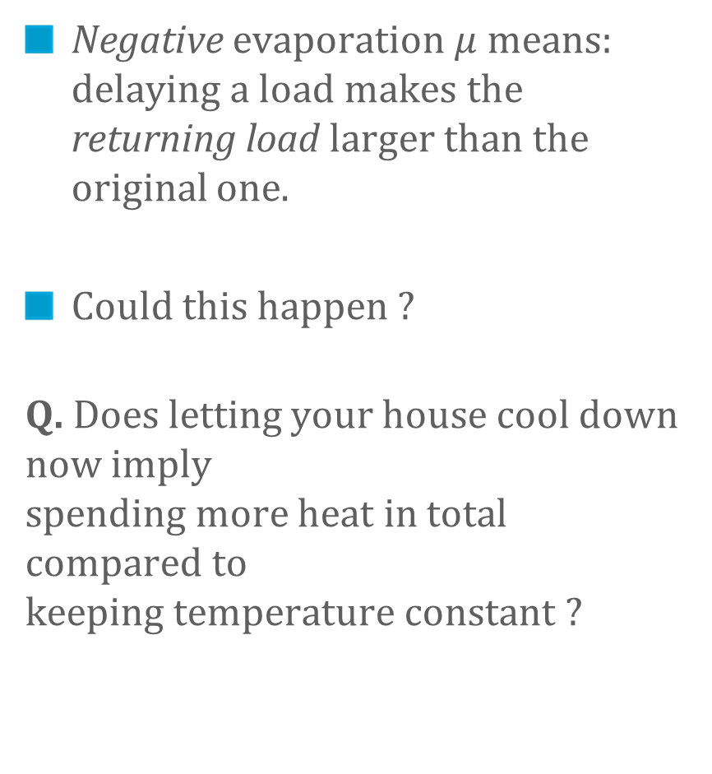
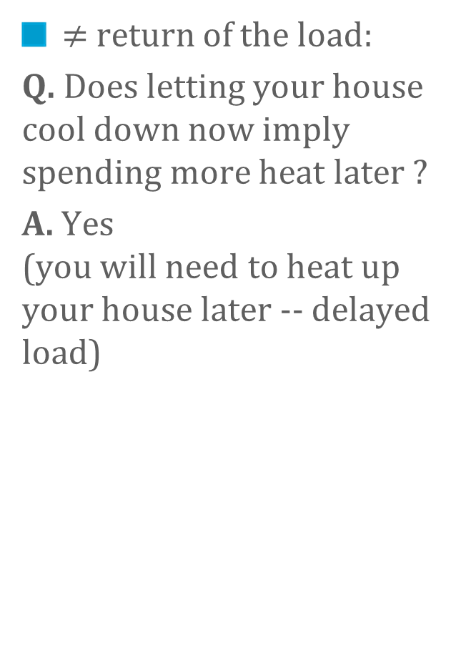
Evaporation
Negative evaporation $μ$ means: delaying a load makes the returning load larger than the original one.
Could this happen ?
Q. Does letting your house cool down now imply spending more heat in total compared to keeping temperature constant ?
$≠$ return of the load:
Q. Does letting your house cool down now imply spending more heat later ?
A. Yes (you will need to heat up your house later -- delayed load)

Slide 26


Assume the house model of [6]
heat provided
to building
leakiness
outside
inertia

Slide 27



$$ε\sum_{t=1}^{τ}{d\left(t\right)}=K\sum_{t=1}^{τ}{\left(T\left(t\right)−θ\left(t\right)\right)}+C(T\left(τ\right)−T(0)$$
efficiency
achieved $t^{o}$
E, total energy provided
Scenario | Optimal | Frustrated
Building temperature | $$T^{∗}\left(t\right), t=0…τ$$ | $$T\left(t\right), t=0…τ, \\ T\left(t\right)≤T^{∗}(t)$$
Heat provided | $$E^{∗}=\frac{1}{ε }\left(K\sum_{t=1}^{τ}{\left(T^{∗}\left(t\right)−θ\left(t\right)\right)}+C\left(T^{∗}\left(τ\right)−T^{∗}\left(0\right) \right)\right)$$ | $$E<E^{∗}$$

Slide 28
Q. Does letting your house cool down now imply spending more heat in total compared to keeping temperature constant ?
A. No, less heat

Slide 29


Findings
Resistive heating system: evaporation is positive.
This is why Voltalis bluepod is accepted by users
If heat = heat pump, coefficient of performance $ε$ may be variable negative evaporation is possible
Electric vehicle: delayed charge may have to be faster, less efficient, negative evaporation is possible

Slide 30
What this suggests about Demand Response:
Negative evaporation makes system unstable Existing demand-response positive experience (with Voltalis/PeakSaver) might not carry over to other loads
Model suggests that large backlogs are possible and unpredictible
Backlogged load is a new threat to grid operation Need to measure and forecast backlogged load
load with demand response
«natural» load
renewables

Slide 31
USING STORAGE TO CopE with Wind Volatility
3.
Gast, Tomozei, Le Boudec. Optimal Storage Policies with Wind Forecast Uncertainties, GreenMetrics 2012

Slide 32



Storage
load
renewables
renewables + storage
Stationary batteries, pump hydro Cycle efficiency $≈70−80\%$

Slide 33










Operating a Grid with Storage
1a. Forecast load $D_{t}^{f}\left(t+n\right)$ and renewable suppy $W_{t}^{f}\left(t+n\right)$ 1b. Schedule dispatchable production $P_{t}^{f}(t+n)$
2. Compensate deviations from forecast by charging / discharging $Δ$ from storage
load
$$D_{t}^{f}(t+n)$$
load
$$D(t+n)$$
renewables
$$Δ(t+n)$$
renewables
$$P_{t}^{f}(t+n)$$
$$P_{t}^{f}(t+n)$$
$$W_{t}^{f}(t+n)$$
$$W(t+n)$$
stored energy
stored energy
$$Δ(t+n)$$

Slide 34








Full compensation of fluctuations by storage may not be possible due to power / energy capacity constraints
$$D(t+n)$$
load
fast ramping
Fast ramping energy source ($CO_{2}$ rich) is used when storage is not enough to compensate fluctuation
Energy may be wasted when
Storage is full
Unnecessary storage (cycling efficiency $<100\%)$
Control problem: compute dispatched power schedule $P_{t}^{f}\left(t+n\right)$ to minimize energy waste and use of fast ramping
$$Δ(t+n)$$
renewables
$$P_{t}^{f}(t+n)$$
$$W(t+n)$$
$$D(t+n)$$
load
renewables
$$P_{t}^{f}(t+n)$$
spilled energy
$$W(t+n)$$

Slide 35


Example: Wind data & forecasting
Aggregate data from UK (BMRA data archive https://www.elexonportal.co.uk/)
Demand perfectly predicted
3 years data
Scale wind production to 20% (max 26GW)
Relative error
Day ahead forecast = 24%
Corrected day ahead forecast = 19%

Slide 36



Example: The Fixed Reserve Policy
Set $P_{t}^{f}(t+n)$ to $D_{t}^{f}\left(t+n\right)−W_{t}^{f}\left(t+n\right)+r^{∗}$ where $r^{∗}$is fixed (positive or negative)
Metric: Fast-ramping energy used (x-axis) Lost energy (y-axis) = wind spill + storage inefficiencies
Efficiency$η = 0.8$
Efficiency$η =1$

Slide 37




A lower bound
Theorem. Assume that the error
conditioned to is distributed as . Then:
(i)
where
(ii) The lower bound is achieved by the Fixed Reserve when storage capacity is infinite.
Depends on storage characteristics
Efficiency, maximum power (but not on size)
Assumption valid if prediction is best possible

Slide 38



Lower bound is attained for .
Efficiency$η = 0.8$
Efficiency$η =1$

Slide 39



The BGK policy [Bejan, Gibbens, Kelly 2012]
aims at keeping a constant level of stored energy
BGK
load
$$D_{t}^{f}(t+n)$$
renewables
$$P_{t}^{f}(t+n)$$
$$W_{t}^{f}(t+n)$$
Is moderately sub-optimal for large energy storage capacity
stored energy
target level $λ$

Slide 40

Small energy storage capacity?
BGK is far from lower bound – can one do better ?

Slide 41





Scheduling Policies for Small Storage
Fixed Reserve: $u=r^{∗}$
BGK: compute $u$ so as to let storage level be close to nominal value $λ$
Dynamic Reserve: compute $u$ so as to minimize average anticipated cost
Solved using an MDP model and policy iteration
load
$$D_{t}^{f}(t+n)$$
$$−u$$
renewables
$$P_{t}^{f}(t+n)$$
$$W_{t}^{f}(t+n)$$

Slide 42
Dynamic Reserve uses a Control Law
Effective algorithm to the Dynamic Reserve policy
Reserve
Reserve
Level of storage
Level of storage
Reserve
Reserve
Level of storage
Level of storage
Efficiency$η = 0.8$
Efficiency$η =1$

Slide 43
The Dynamic Reserve policies outperform BGK
Trying to maintain a fixed level of storage is not optimal
BGK: maintain fixed storage lvl
Fixed Reserve
Dynamic reserve
Lower bound
Efficiency$η = 0.8$
Efficiency$η =1$

Slide 44

What this suggests about Storage
(BGK policy: ) Maintain storage at fixed level: not optimal
Worse for low capacity
There exist better heuristics
Lower bound (valid for any type of policy)
depends on and maximum power
Tight for large capacity (>50GWh)
Still gap for small capacity
50GWh and 6GW is enough for 26GW of wind
Quality of prediction matters

Slide 45
Conclusion: Demand Response vs Storage
Demand Response
Storage
Attractive (little capital investment)
Unpredictable effects
Capital investment
Can be managed and understood

Slide 46
Questions ?
[1] Cho, Meyn – Efficiency and marginal cost pricing in dynamic competitive markets with friction, Theoretical Economics, 2010
[2] Le Boudec, Tomozei, Satisfiability of Elastic Demand in the Smart Grid, Energy 2011 and ArXiv.1011.5606
[3] Le Boudec, Tomozei, Demand Response Using Service Curves, IEEE ISGT-EUROPE, 2011
[4] Le Boudec, Tomozei, A Demand-Response Calculus with Perfect Batteries, WoNeCa, 2012
[5] Papavasiliou, Oren - Integration of Contracted Renewable Energy and Spot Market Supply to Serve Flexible Loads, 18th World Congress of the International Federation of Automatic Control, 2011
[6] David MacKay, Sustainable Energy – Without the Hot Air, UIT Cambridge, 2009
[7] Bejan, Gibbens, Kelly, Statistical Aspects of Storage Systems Modelling in Energy Networks. 46th Annual Conference on Information Sciences and Systems, 2012, Princeton University, USA.

